Slide 1
Project:Opal Micron
TMAH & IPA Bio-degradation study
1

Slide 2
Biological Lab Testing
Current lab testing
High salinity (complete)
Acclimatized and bio-growth documented
IPA as C source (complete)
Acclimatized and bio-growth documented as well as C degradation
TMAH decomposition, in progress
TMAH results from lab have not arrived yet, should do so shortly
Nitrification/Denitrification batch test
Nitrification is accelerating
First kinetic values available
Simultaneous denitrification probable, to be confirmed with ash analysis
Denitrification and biomass growth test with MicroC to be started (Batch 2)

Slide 3
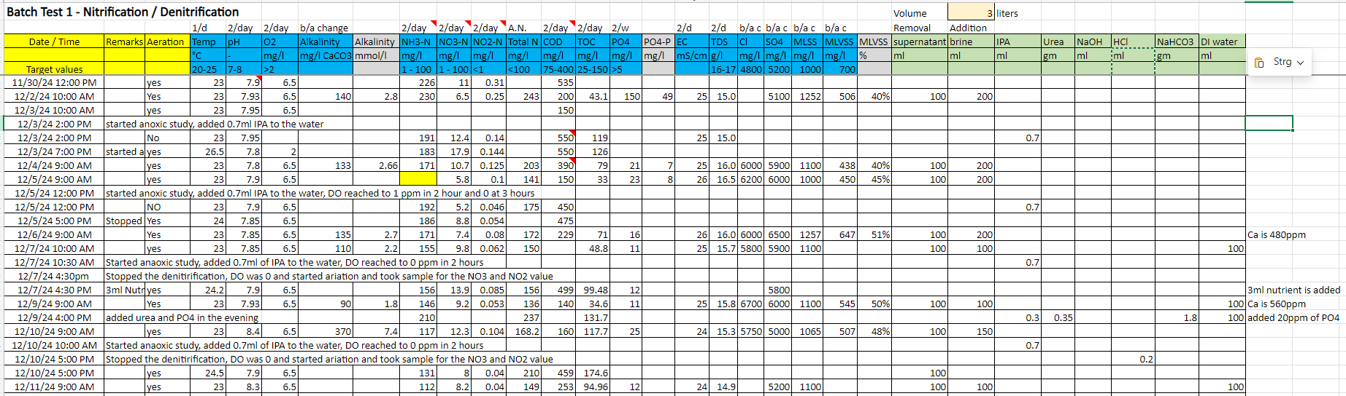
Biological Lab Testing – Current values Batch 1

Slide 4
Biological Lab Testing – Kinetics Batch 1
Current results
Nitrification has accelerated (100 mg/l in 41 hours compared to 110 mg/l over the course of 6 days)
During these 41 hours, 1,71 g COD (from IPA) have been added and degraded -> max. Incorporation would be 34 mg/l
Denitrification is probably simultaneous (there are non-aerated sludge pockets in the corners and under the diffusers)
F/M load in the last 9 days was 0,17 g COD/g MLSS and day (up from 0,1 the week before – compared to 0,13 – 0,16 in design)
MLVSS has stabilized at around 50 %, both MLSS and MLVSS are constant (with biomass removal for testing)
Kinetics
Biomass growth is 0,17 g MLSS per g COD (design 0,23 g MLSS / g COD) - considering only MLVSS, growth is 0,085 g MLVSS / g COD
When counting biomass removal for testing as WAS, we get an SRT = 33 d (for the last 9 days of operation)
Nitrification rate (after deducing incorporation) is 0,075 g N/g MLVSS and day (compared to design value of 0,06)

Slide 5
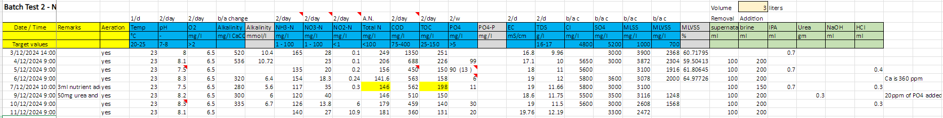
Biological Lab Testing – Current values Batch 2

Slide 6
Biological Lab Testing – Results and next steps Batch 2
Current results
We are starting to observe accelarating IPA removal, denitrification not stable yet
TDS has been increased over the last week, approaches OPAL values
MLSS concentration is slowly going down, approaching equilibrium
Next steps
We could use this reactor to test kinetics and removal rates with MicroC instead of IPA
We would have to simulate MicroC, but based on the SDS that should not be a problem

Slide 7
Biological Lab Testing
High salinity (complete)
Acclimatized and bio-growth documented
IPA as C source (complete)
Acclimatized and bio-growth documented as well as C degradation
TMAH decomposition, in progress
TMAH results from lab have arrived, values relatively low -> retest
Nitrification/Denitrification batch test
Batch 1 with IPA as carbon source
Batch 2 with glycerol as carbon source
Kinetic values updated
First results of ash analysis

Slide 8
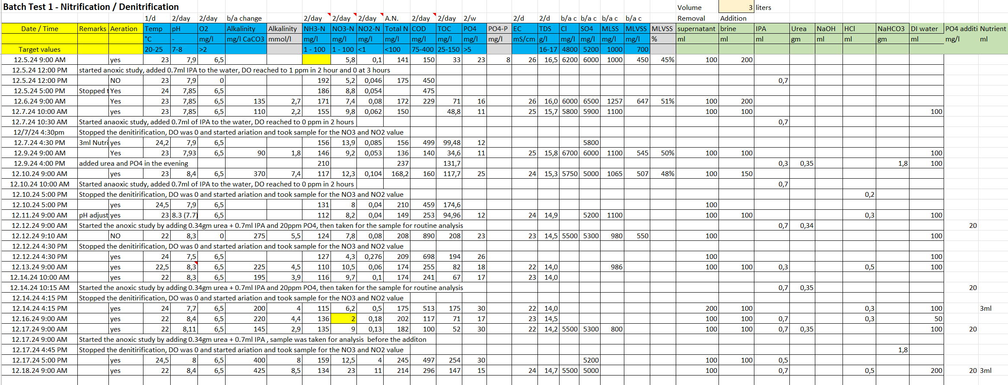
Biological Lab Testing – Current values Batch 1

Slide 9
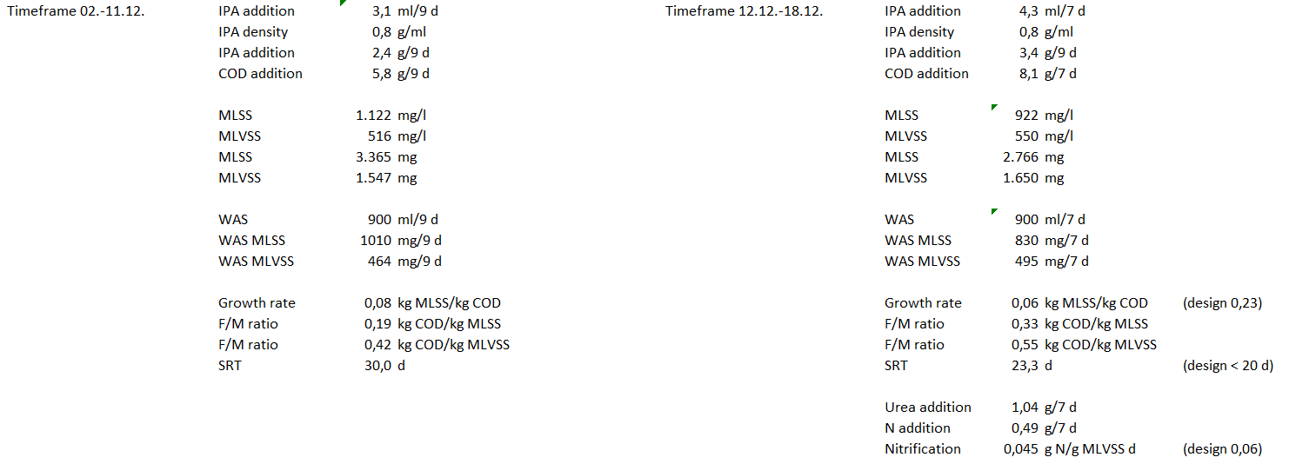
Biological Lab Testing – Kinetics Batch 1

Slide 10
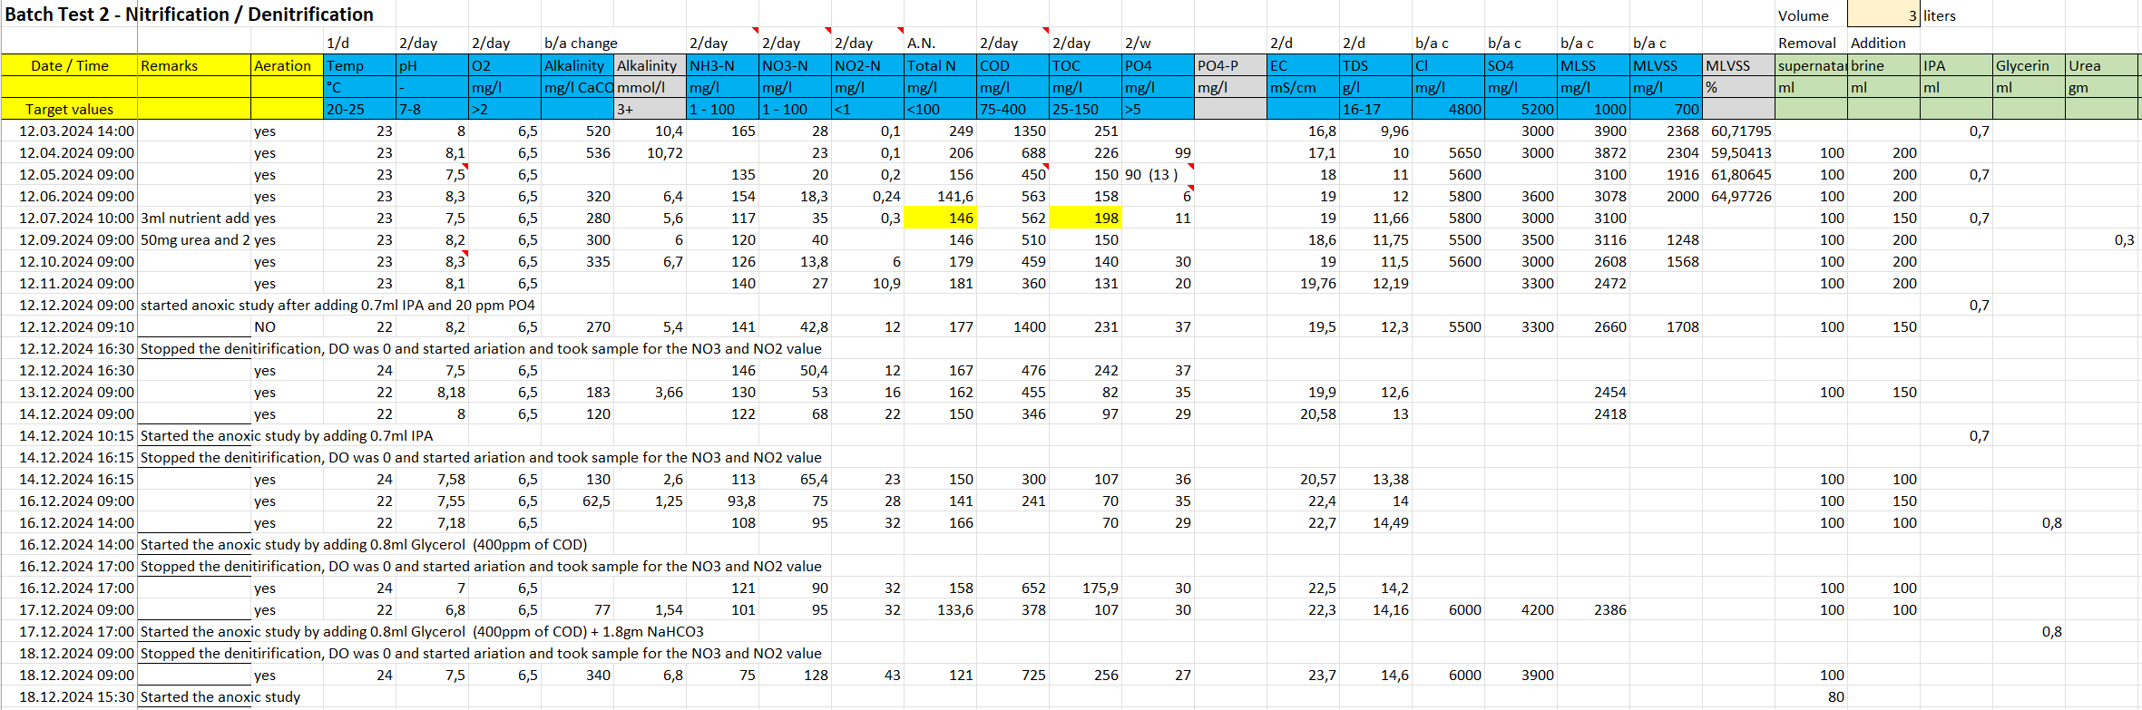
Biological Lab Testing – Current values Batch 2

Slide 11
Biological Lab Testing – Results and next steps Batch 2
Current results
Carbon source has been switched to glycerol for the last few days, aerobic degradation works fine
Bacteria are still in the adaptation phase considering glycercol use for denitrification
MLSS concentration seems to stabilise at a slightly lower level
Next steps
Increased use of anoxic phases to kick-start denitrification with glycerol
Next urea feeding only once denitrification gets established

Slide 12
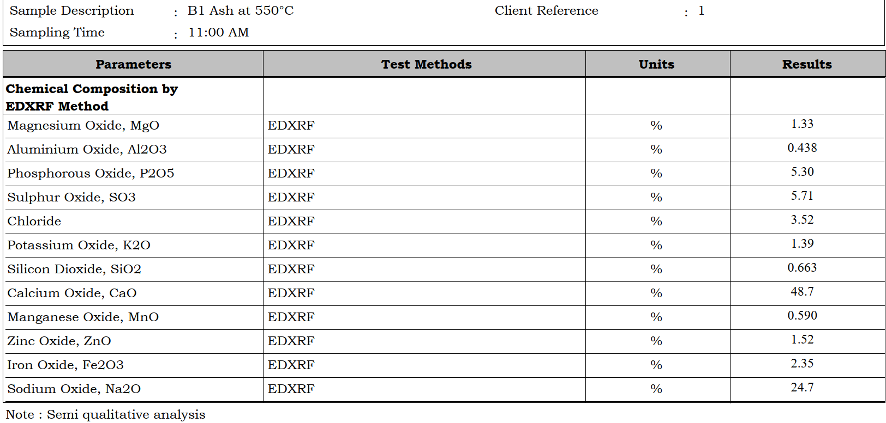
Biological Lab Testing – Ash testing
Results from laboratory for batch 1

Slide 13
Biological Testing – Batch 1
IPA degradation: Microbe are completely acclimatized to IPA food source, degradation rate is good and its increasing with time, currently 400 to 500 mg/l of COD is degraded, and its rate is increasing as the MLSS is increasing
MLSS: Growth rate is good, today it has reached to 1450 mg/l (from the lowest of 800 mg/l - five days back), its majorly depends on the volume of food is provided, if it is starving then MLSS goes down. With the increase in MLSS concentration, MLVSS ratio will also increase, if MLSS reaches to 2000ppm, the degrading rate and MLVSS ratio will be better
Denitrification: Both nitrification and denitrification process is going well, current cycle the NO3 and NO2 has reduced from 23ppm to 2 ppm and 11ppm to 2ppm respectively, NH3 is getting reduced to NO3 and NO2 during the aerobic period
Overall the Batch reactor is under dynamic mode (nitrification and denitrification) and performing good
Will continue to monitor the studies for another a week or 2 week, so that we can generate complete dynamics of IPA and NH3 degradation
Next coarse of action planned for batch 1
After understanding the complete dynamics, will load TMAH to the reactor incrementally and monitor the dynamics (which will be final objective of the project)

Slide 14
Biological Testing – Batch 2
IPA degradation: Microbe are getting acclimatized to IPA food source, IPA is getting degraded but not as fast Batch 1 reactor
Glycerin degradation: Started to add glycerin, to see the impact of MLSS and denitrification kinetics, glycerin is getting degraded at faster rate, we have started observing denitrification process, there is reduction in NO3 and NO2 values
MLSS: Growth rate is sustained at ~2500mg/l, anticipating further growth in the colonies
Overall the Batch reactor 2 is under dynamic mode (nitrification and denitrification) and showing positive outcomes for both IPA and glycerin degradation along with denitrification
Next coarse of action planned for batch 2
Will start adding the TMAH incrementally (from 20 ppm to 75ppm) from tomorrow
Glycerin will be added along with TMAH, and will observe the complete Kinetics of nitrification and denitrification

Slide 15
TMAH Degradation
Protocols to quantify the TMAH degradation
Will be preparing 20ppm to 100ppm TMAH sample (using existing 98% salt)
Will establish the TN, TOC and TKN database for the above TMAH standard
Will evaluate the TN, TOC and TKN values for the combination – 50ppm TMAH + 400ppm of COD from glycerin + 50ppm of NH3 from urea (which is the food source in batch reactor 2)
Will monitor the TN, TOC and TKN value during degradation process
TMAH analysis
will validate the HPLC method carried out by the local lab (will be sending the 50ppm TMAH sample for the validating the results)
If the results are validated and satisfied, will give the actual degraded bioreactor sample (initial and final degraded sample)
If external lab results are not satisfied, will send the sample to Taiwan lab for the TMAH analysis

Slide 16
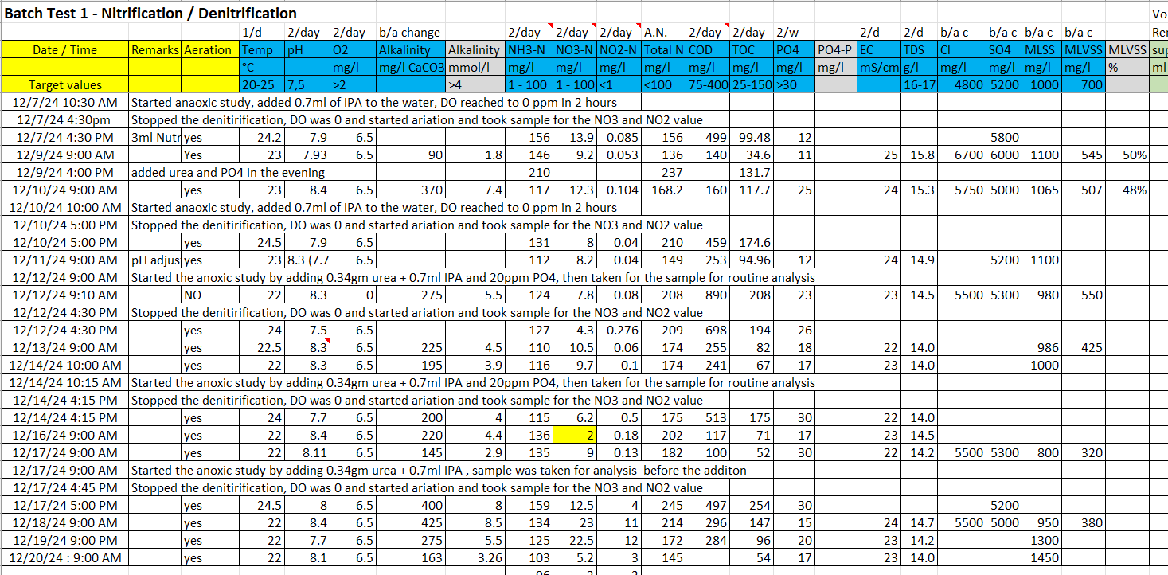

Slide 17
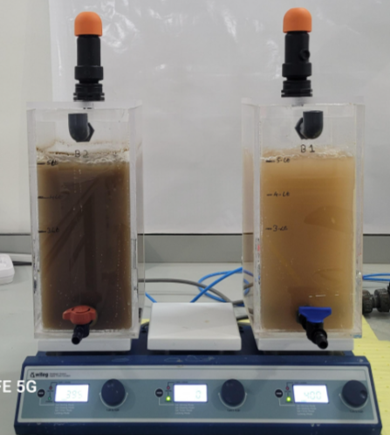
TMAH and IPA Degradation Batch Test Setup
Batch – 2 : TMAH Degradation
Started the batch 2 : 16th Dec with new STP sludge
Status: TMAH is getting degraded, observing reduction in TOC and increase in NH3 values
Initial food source: Glycerin
Started adding TMAH : 27th Dec
Initial TMAH added : 500ppm
Total TMAH : 1000ppm
Microbes are getting acclimatized to TMAH food source, in next 10 to 12 days, it will be completely acclimatized, in parallel will carry out denitrification studies
Batch – 1: IPA Degradation fallowed by Nitrification and Denitrification study
Started the Batch 1 : 25th Nov, in continuation with IPA degradation
Current MLSS: 3800 mg/l
Current COD loading: ~620 mg/day
Ammonia reduction: ~50mg/day
Denitrification: ~30 mg NO3-N reduced in 8 hours & ~12 mg of NO2-N reduced in 8 hour batch study
Overall ~100mg of NH4-N is completely reduced within 48 hours in batch study
Both IPA and Ammonia is getting reduced

Slide 18
MLSS Growth rate – IPA as the food source
Started with 75 to 100 mg/day of COD reduction
Now, there is a reduction of ~620 mg/day COD reduction
F/M ratio is close to 0.2
MLSS is keep increasing, will take it up to 5000ppm in next 10 to 12 days

Slide 19
Status and Observations – TMAH Study
1) TMAH degradation is validated by TOC observation
2) TMAH degradation by observing NH3-N accumulations
 | TOC in PPM
Initial TOC | 194
After 1000ppm of TMAH | 705
Day 7 | 500
Inferences:
Currently culture is getting acclimatized to TMAH food source, as there is reduction of TOC and it need another 10 to 15 days for complete acclimatization, then we go for understanding the kinetics of degradation including NO3 and NO2 reduction
There is increase in NH3-N in the solution

Slide 20
TMAH Degradation
Addition of 500ppm TMAH
Addition of 500ppm TMAH
TMAH getting degraded
TMAH degraded increase in NH3-N

Slide 21
TMAH Evaluation
TOC and TN values for given TMAH concentration
 | PPM | TOC in ppm | TN in ppm
TMAH | 10 | 5.17 | 1.56
 | 25 | 12.62 | 3.93
 | 50 | 25.83 | 8.4
 | 75 | 36.83 | 11.96
 | 100 | 51.22 | 16.19

Slide 22
OPAL Biodegradation Study
Objective: To demonstrate the TMAH and IPA degradation under high saline environment using aerobic biological environment
Status of the project: carried out all the required studies, closing the studies in this week
Observation and Outcome from the study
Acclimatization of aerobic and anerobic microbes under high saline environment – TDS of ~17gm/l
MLVSS was maintained at 2500 mg/l to 3000 mg/l
Complete Degradation of IPA (400ppm) in 24 hours and TMAH (30ppm) in <48 hours
Conversion of NH3 to NO3 and NO2 under aerobic environment was very good
Further NO3 and NO2 was reduced from the system under Aerobic environment
Demonstrated the continuous degradation and reduction of food sources for a period of 4 months
Bacteria’s was completely adapted to TMAH and IPA food source
Successfully demonstrated both aerobic and an-aerobic studies in a single bio-reactor (Sequential batch studies)

